Slide 1
The D3 JavaScript Library and Accessible Data Visualization
Presented By: Brian P. McNeilly
CSUN 2018 Assistive Technology Conference
March 21, 2018

Slide 2

What is D3?
D3 & Accessible Data Visualization
Data Driven Documents
JavaScript library
Designed for rendering complex data visualization
Extremely customizable
Applications to other frameworks
D3plus & Chart.js

Slide 3
SVG vs HTML
D3 & Accessible Data Visualization
SVG
Pros
Built for Graphics
Stable presentation
Cons
Less ARIA support
HTML
Pros
Wider ARIA support
More well known
Cons
Rendering inconsistencies

Slide 4
Examples

Slide 5
Bar Chart

Slide 6
Making Accessible Bar Charts
D3 & Accessible Data Visualization
Thinking About Bar Charts
Axes
Bars
Color
Interaction
D3 Challenges

Slide 7
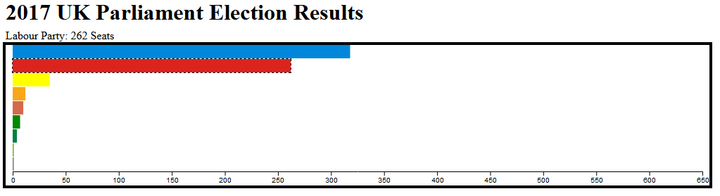
Sample Bar Chart: 2017 UK Elections
D3 & Accessible Data Visualization

Slide 8
Line Graph

Slide 9
Making Accessible Line Graphs
D3 & Accessible Data Visualization
Thinking About Line Graphs
The Line
Axes
The “pip”
D3 Challenges

Slide 10
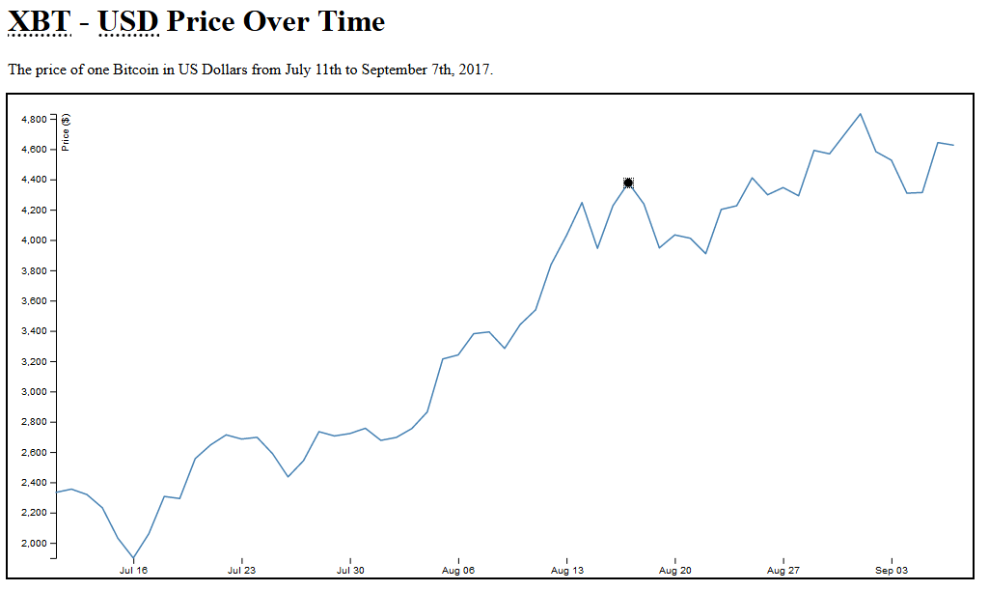
Sample Line Graph: Bitcoin Price in USD
D3 & Accessible Data Visualization

Slide 11
Stacked Chart

Slide 12
Making Accessible Stacked Charts
D3 & Accessible Data Visualization
Thinking About Stacked Charts
“Bars”
Group Identification
Ownership
D3 Challenges
D3, Ownership, and d3.stack()

Slide 13
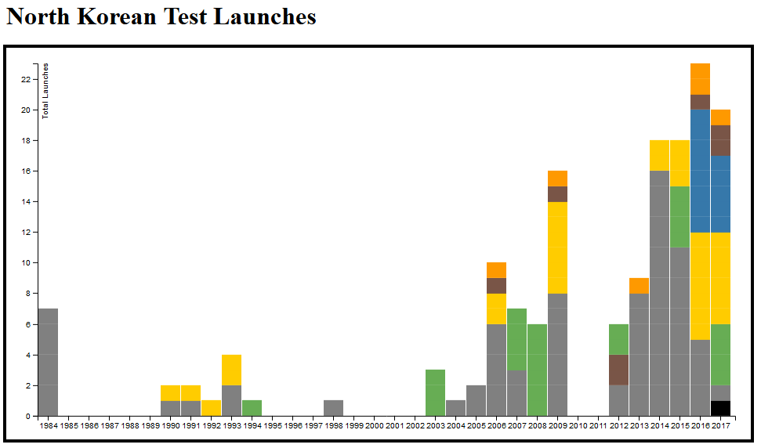
Sample Stacked Chart: DPRK Launches
D3 & Accessible Data Visualization

Slide 14
Flare / Sunburst

Slide 15
Making Accessible Flares / Sunbursts
D3 & Accessible Data Visualization
Thinking About Flares / Sunbursts
Group identification
Ownership & levels
Interaction & content updates
D3 Challenges
Tackling ownership within d3.hierarchy()
Data & aria-owns

Slide 16
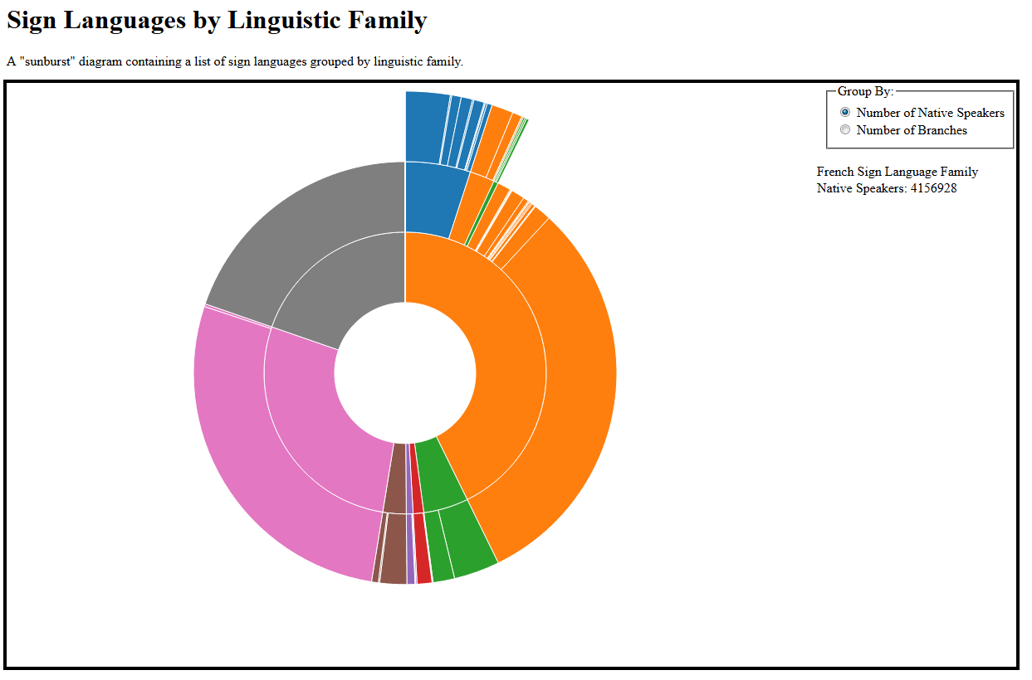
Sample Flare: Sign Language Families
D3 & Accessible Data Visualization

Slide 17
Looking Forward

Slide 18
Where Do We Go From Here?
D3 & Accessible Data Visualization
Making accessible charts seamless
D3plus or Chart.js
SVG-AAM & SVG2
SVG support for browser high contrast mode!

Slide 19
Any Questions?

Slide 20





Thank You/Resources
D3 & Accessible Data Visualization
Contact Us
Brian McNeilly brian.mcneilly@levelaccess.com
Follow Us
@LevelAccessA11y
Level-Access
Level Access
Level Access Blog
Slide Deck Available for Download at: https://www.levelaccess.com/csun18/

Slide 21
Additional Resources & image citations
D3 & Accessible Data Visualization
Chart / Graph / Diagram Links
2017 UK Parliamentary Election Results Bar Chart
Bitcoin Price In US Dollars Line Graph
2017 North Korean Test Launches Stacked Chart
Sign Languages By Linguistic Family Flare/Sunburst Diagram
Image Citations
D3 Logo via Wikipedia
All other images are screenshots from the above links

